Slide 1
4.0 Continuous-time Fourier Transform
4.1 From Fourier Series to Fourier Transform
Fourier Series : for periodic signal
See Fig. 3.6, 3.7, p.193, 195, Fig, 4.2, p.286 of text
aperiodic : T→∞ , ω₀ → 0

Slide 2
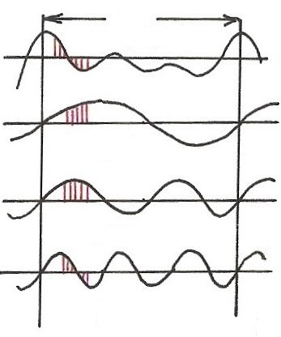
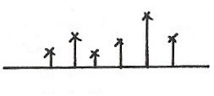
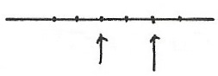
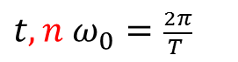
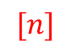
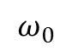

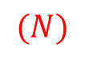
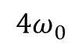
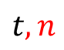
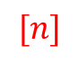
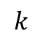
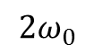
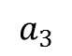
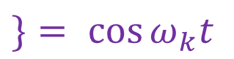
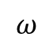
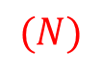

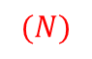
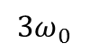
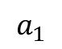


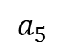
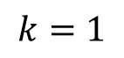

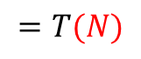
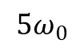
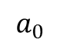
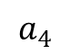
Harmonically Related Exponentials for Periodic Signals
(P.11 of 3.0)
$$[n]$$
T
$$V=\left\{x(t) | x(t) \text{perodic} \text{fundamental} \text{period} \right\}$$
$$(N)$$
$$[n]$$
$$=T(N)$$
$$t, n$$
$$a_{4}$$
$t, n$ $ω_{0}=\frac{2π}{T }$
$$a_{1}$$
$$a_{3}$$
$$a_{5}$$
$$k=1$$
$$(N)$$
$$a_{0}$$
$$k$$
$$t, n$$
$$0 1 2 3 4 5$$
$$k=2$$
$$ω$$
$$0$$
$$ω_{0}$$
$${3ω}_{0}$$
$${5ω}_{0}$$
$$t, n$$
$${2ω}_{0}$$
$${4ω}_{0}$$
$$k=3$$
All with period T: integer multiples of ω₀
Discrete in frequency domain
$$(N)$$

Slide 3
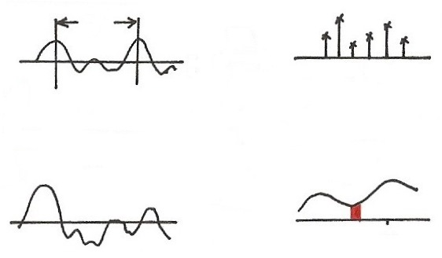
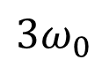

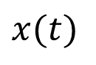

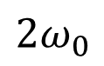
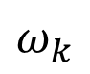
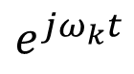
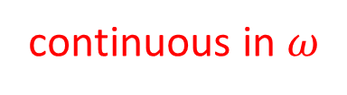
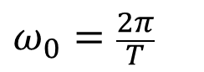
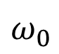
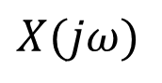
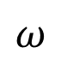
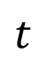
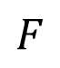
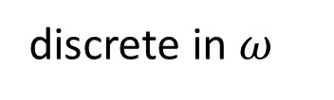
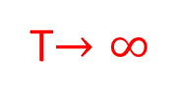
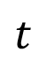


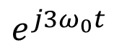
Fourier Transform
T
FS
$$t$$
$$ω$$
0
$$ω_{0}$$
$${3ω}_{0}$$
$$ω_{0}=\frac{2π}{T}$$
$${2ω}_{0}$$
$$e^{j3ω_{0}t}$$
T$→∞$
$$ω_{0}→0$$
periodic in $t$
discrete in $ω$
$$x(t)$$
$$X(jω)$$
$$F$$
$$t$$
$$jω$$
$$ω_{k}$$
$$e^{jω_{k}t}$$
aperiodic in $t$
continuous in $ω$

Slide 4
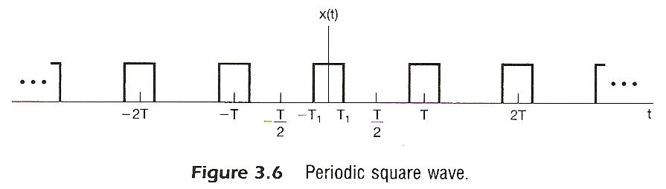

Slide 5
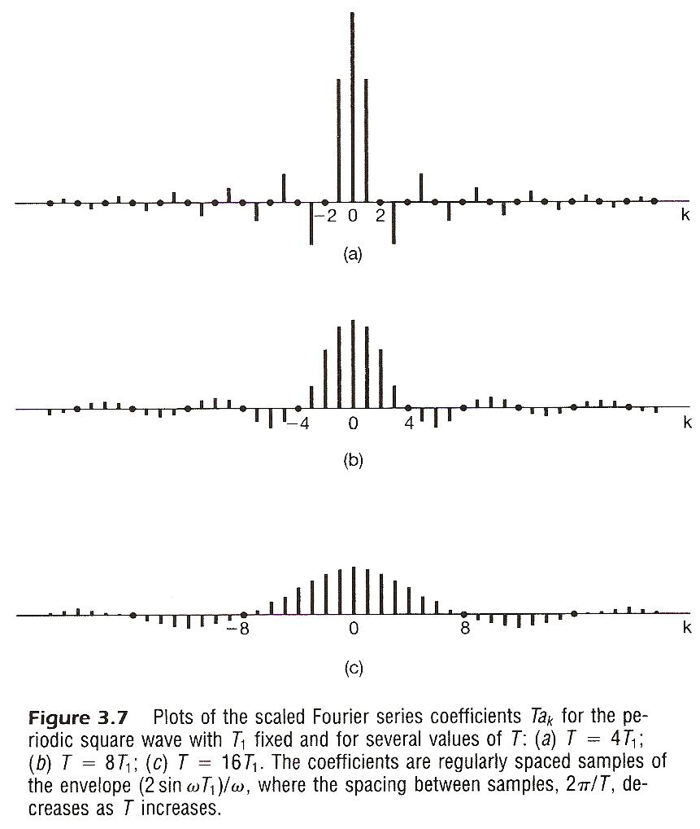

Slide 6
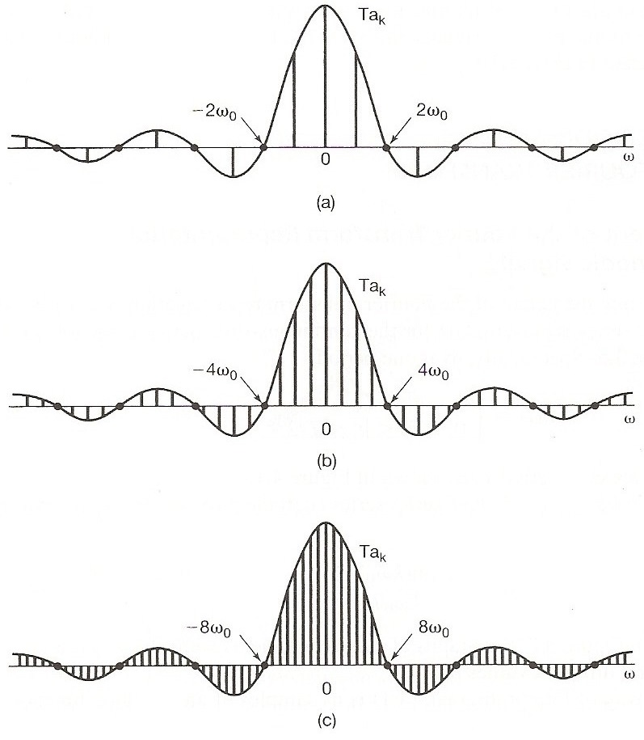
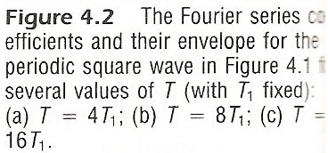
See Fig. 3.6, 3.7, p.193, 195, Fig, 4.2, p.286 of text

Slide 7
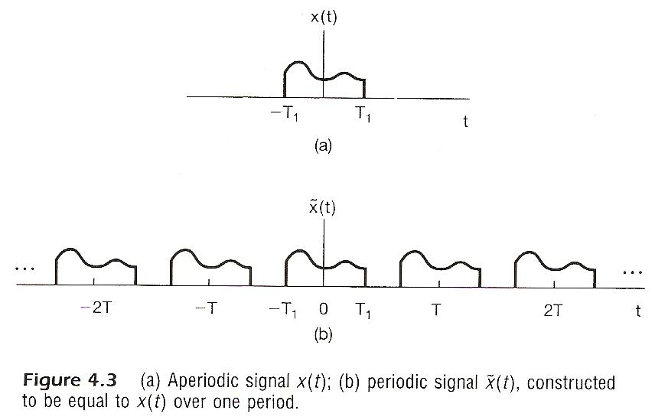
Considering x(t), x(t)=0 for | t | > T₁
construct

Slide 8
Considering x(t), x(t)=0 for | t | > T₁
Fourier series for
Defining envelope of Ta_{k} as X(jω)

Slide 9
Considering x(t), x(t)=0 for | t | > T₁
as

Slide 10
Considering x(t), x(t)=0 for | t | > T₁
as
spectrum, frequency domain
Fourier Transform
signal, time domain Inverse Fourier Transform
Fourier Transform pair, different expressions
very similar format to Fourier Series for periodic signals

Slide 11
Convergence Issues
Given x(t)

Slide 12
Convergence Issues
It can be shown
is obtainable (finite) for every ω
zero energy for the difference signal
differences at isolated points are possible
converges to x(t) at continuous points, but to averages at discontinuities

Slide 13
Convergence Issues
Dirichlet’s conditions
absolutely integrable
finite number of maxima and minima within any
finite interval
finite number of discontinuities with finite values
within any finite interval

Slide 14
Fourier Transform for Periodic Signals –
Unified Framework
Given x(t)
(easy in one way)

Slide 15
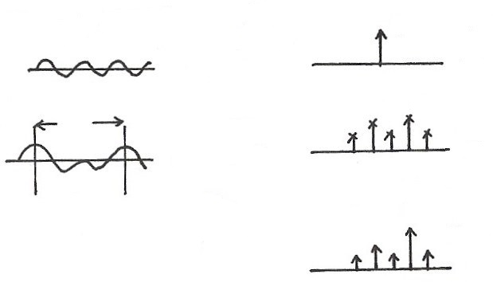
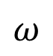
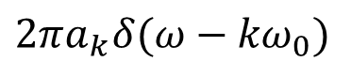





Unified Framework: Fourier Transform for Periodic Signals
$$2πδ(ω−ω_{0})$$
$$e^{jω_{0}t}$$
$$F$$
$$t$$
$$ω$$
$$ω_{0}$$
T
$$a_{k}$$
$$x(t)$$
FS
$$ω$$
$$t$$
$${kω}_{0}$$
$$F$$
$$X(jω)$$
$$2πa_{k}δ(ω−{kω}_{0})$$
If
$$ω$$
$${kω}_{0}$$
F

Slide 16
4.2 Properties of Continuous-time Fourier
Transform
Linearity

Slide 17

Linearity
(P.27 of 3.0)
Linearity
$$\vec{x}=(a_{1},a_{2},a_{3},⋯)$$
$$\vec{y}=(b_{1},b_{2},b_{3},⋯)$$
$$A\vec{x}+B\vec{y}=(Aa_{1}+Bb_{1},Aa_{2}+Bb_{2},⋯)$$

Slide 18
Time Shift
linear phase shift (linear in frequency) with amplitude unchanged

Slide 19











Time Shift
(P.28 of 3.0)
phase shift linear in frequency with amplitude unchanged
$$a_{k} e^{jkω_{0}(t−t_{0})}=e^{−jkω_{0}t_{0}} a_{k} e^{jkω_{0}t}$$
$$t_{0}$$
$${x(t−t}_{0})$$
$$x(t)$$
$$π$$
$$ω_{0}$$
$$2π$$
$${2ω}_{0}$$
$$3π$$
$${3ω}_{0}$$
$${kω}_{0}t_{0}$$

Slide 20







Time Shift
$$Im$$
$$Im$$
$$Re$$
$$Im$$
$$Re$$
$$Re$$
$$ω$$

Slide 21
Conjugation

Slide 22

Conjugation
(P.32 of 3.0)
unique representation

Slide 23

Conjugation
Unique representation for orthogonal bases
Conjugation

Slide 24

Even/Odd Properties
Conjugation Property
o

Slide 25
Even/Odd Properties
x(t) both real and even
Time Reversal
x(t) real and odd

Slide 26
Differentiation/Integration
dc term

Slide 27

Differentiation
(P.33 of 3.0)

Slide 28

Differentiation
$$\left|jω⋅X(jω)\right|=\left|ω\right|⋅\left|X(jω)\right|$$
$$\left|ω\right|$$
$$\left|X(jω)\right|$$
$$\left|ω\right|\left|X(jω)\right|$$
$$ω$$
Enhancing higher frequencies
De-emphasizing lower frequencies
Deleting DC term ( =0 for ω=0)

Slide 29





Integration
dc term
$$\frac{1}{j}=e^{−j90°}$$
$$\left|\frac{1}{jω}\right|⋅\left|X(jω)\right|=\left|\frac{1}{ω}\right|⋅\left|X(jω)\right|$$
$$\left|\frac{1}{ω}\right|$$
$$X(jω)$$
$$ω$$
Enhancing lower frequencies (accumulation effect)
De-emphasizing higher frequencies
(smoothing effect)
Undefined for ω=0
Accumulation

Slide 30


Parseval’s Relation
total energy: energy per unit time integrated over the
time
total energy: energy per unit frequency integrated
over the frequency
$$\vec{A}=\sum_{i}{a_{i}}{\hat{v}}_{i}=\sum_{k}{b_{k}}{\hat{u}}_{k}$$
$${\left\| \vec{A} \right\|}^{2}=\sum_{i}{{\left|a_{i}\right|}^{2}}=\sum_{k}{{\left|b_{k}\right|}^{2}}$$

Slide 31
















Time/Frequency Scaling
(time reversal)
$$x(t)$$
$$X(jω)$$
$$F$$
$$t$$
$$ω$$
$$\frac{1}{\left|a\right|} X\left(j\frac{ω}{a}\right), a>1$$
$$x\left(at\right), a>1$$
$$t$$
$$F$$
$$ω$$
$$x\left(at\right), a<1$$
$$\frac{1}{\left|a\right|} X\left(j \frac{ω}{a}\right), a<1$$
$$F$$
$$t$$
$$ω$$
See Fig. 4.11, p.296 of text

Slide 32

inverse relationship between signal “width” in time/frequency domains

Slide 33

















Single Frequency
$$\cos{ω_{0}t}=\frac{1}{2} \left(e^{jω_{0}t}+e^{−jω_{0}t}\right)$$
$$F$$
$$ω$$
$$t$$
$${−ω}_{0}$$
$$ω_{0}$$
$$ω$$
$$F$$
$$t$$
$${−2ω}_{0}$$
$${2ω}_{0}$$
$$ω$$
$$F$$
$$t$$
$$−{\frac{1}{2} ω}_{0}$$
$${\frac{1}{2} ω}_{0}$$

Slide 34

Time Scaling
(P.30 of 3.0)
positive real number
periodic with period T/α and fundamental frequency αω₀
a_{k} unchanged, but x(αt) and each harmonic component are different

Slide 35






Data Transmission
1
1
0
1
$$F$$
$$ω$$
$$τ$$
W:
$τ$:
T: bit duration
bandwidth
pulse width
$$W∝\frac{1}{τ}≥\frac{1}{T}=r$$
: bit rate
example: digital transmission
(required bandwidth) α (bit rate)

Slide 36

Time Reversal
(P.29 of 3.0)
the effect of sign change for x(t) and a_{k} are identical
unique representation for orthogonal basis

Slide 37

Time Reversal
Unique representation for orthogonal bases

Slide 38
Duality
time/frequency domains are kind of “symmetric” except for a sign change (and a factor of 2π) --- “two domains”
See Fig. 4.17, p.310 of text

Slide 39












Duality
$$x(t)$$
$$y(t)$$
$$F$$
$$z\left(ω\right)X(jω)$$
$$t$$
$$ω(jω)$$
0
$$F^{−1}$$
$$z(t)$$
$$2πy(−ω)$$
$$F$$
$$t$$
$$ω$$
0

Slide 40


Slide 41
Considering x(t), x(t)=0 for | t | > T₁
as
(P.10 of 4.0)
spectrum, frequency domain
Fourier Transform
signal, time domain Inverse Fourier Transform
Fourier Transform pair, different expressions
very similar format to Fourier Series for periodic signals

Slide 42






















Signal Representation in Two Domains
Time Domain Basis Frequency Domain Basis
$$X(jω)$$
$$x(t)$$
$$F$$
$$t$$
$$ω$$
$$t_{1} t_{2}$$
$$ω_{1} ω_{2}$$
$$t$$
$$2πδ(ω−ω_{1})$$
$$ω$$
$$δ(t−t_{1})$$
$$t_{1}$$
$$ω_{1}$$
$$t$$
$$2πδ(ω−ω_{2})$$
$$ω$$
$$δ(t−t_{2})$$
$$t_{2}$$
$$ω_{2}$$
$$⋮$$
$$⋮$$

Slide 43















Signal Representation in Two Domains
Time Domain Basis Frequency Domain Basis
{$δ\left(t−t_{k}\right), −∞<t_{k}<∞$}
{$2πδ\left(ω−ω_{k}\right), −∞<ω_{k}<∞$}
$$F$$
$$e^{−jt_{k}ω}$$
$$δ\left(t−t_{k}\right)$$
$$ω$$
$$t$$
$$t_{k}$$
$$e^{+jω_{k}t}$$
$$F$$
$$2πδ\left(ω−ω_{k}\right)$$
$$ω$$
$$t$$
$$ω_{k}$$

Slide 44









Signal Representation in Two Domains
Time Domain Basis Frequency Domain Basis
$$A$$
$$δ\left(t−t_{3}\right)$$
$$2πδ\left(ω−ω_{3}\right)$$
$$ω_{2}$$
$$t_{2}$$
$$ω_{1}$$
$$t_{1}$$
$$\vec{A}=\sum_{i}{a_{i} }{\vec{v}}_{i} =\sum_{k}{b_{k}{\vec{u}}_{k}} \text{(}合成\text{)}$$
$a_{i}=\vec{A}⋅{\vec{v}}_{i} b_{k}=\vec{A}⋅{\vec{u}}_{k}$ (分析)

Slide 45




Signal Representation in Two Domains
Time Domain Basis Frequency Domain Basis
$$\vec{A}=\sum_{i}{a_{i} }{\vec{v}}_{i}$$
$$(\sum_{k}{c_{k} }{\vec{u}}_{k})$$
$$=\sum_{k}{( ⋯ ) }{\vec{u}}_{k}$$
$$\vec{A}=\sum_{k}{b_{k} }{\vec{u}}_{k}$$
$$(\sum_{i}{d_{i} }{\vec{v}}_{i})$$
$$=\sum_{i}{( ⋯ ) }{\vec{v}}_{i}$$
$$b_{k}$$
$$a_{i}$$

Slide 46

Signal Representation in Two Domains
Time Domain Basis Frequency Domain Basis

Slide 47
Duality
If any characteristics of signals in one domain implies some characteristics of signals in the other domain, the inverse is true except for a sign change (dual properties)
modulation property

Slide 48







Modulation Property
$$ω_{0}$$
$$e^{jω_{0}t}\left(e^{jω_{k}t}\right)=e^{j{(ω}_{k}+ω_{0})t}$$
modulation:
frequency translation
shift in frequency
$$ω$$
$$ω_{k}$$
$$ω_{k}+ω_{0}$$
Multiplication Property
$$e^{jω_{0}t}⋅x(t)⟷\frac{1}{2π} [2πδ({ω−ω}_{0})∗X(jω)]$$
$=X(j(ω−ω_{0}))$

Slide 49
Convolution Property
System Input/Output Relationship
superposition property
closed-form solution
frequency response

Slide 50












Input/Output Relationship
(P.5 of 3.0)
$$x(t)$$
$$y(t)$$
Time Domain
$$δ(t)$$
$$h(t)$$
$$t$$
$$t$$
0
0
Frequency Domain
$$ω$$
$$ω$$
$$ω_{1}$$
$$ω_{3}$$
$$ω_{5}$$
$$ω_{1}$$
$$ω_{3}$$
$$ω_{5}$$

Slide 51
System Characterization
Superposition Property
continuous-time
(P.9 of 3.0)
discrete-time
each frequency component never split to other frequency components, no convolution involved
desirable to decompose signals in terms of such eigenfunctions

Slide 52

Convolution Property

Slide 53
Convolution Property
unit impulse response h(t)
frequency response or transfer function H(jω)
convolution in time domain reduced to multiplication in frequency domain
cascade of two systems implies product of the two frequency responses, independent of the order of the cascade
example: filtering of signals
See Fig. 4.20, 4.21, p.318, 319 of text

Slide 54









Filtering of Signals
1
1
0
1
$$H(jω)$$
$$P(jω)$$
$$p(t)$$
$$F$$
$$t$$
$$ω$$
0
$$H(jω)$$
$$ω$$
0

Slide 55


Slide 56


Slide 57











Realizable Lowpass Filter
$$F$$
$$h_{1}(t)$$
$$\left|H_{1}(jω)\right|$$
$$h_{2}(t)$$
$$F$$
$$\left\{\begin{aligned}\left|H_{2}(jω)\right| \\ ∠H_{2}(jω)\end{aligned}\right.$$
$$t$$
$$ω$$
$$−T$$
0
$$T$$
0
$$T$$
$$2T$$
0

Slide 58
Differentiation/Integration
(P.26 of 4.0)
dc term

Slide 59









Integration
Duality
$$u\left(t\right)=\int_{−∞}^{t}{δ}\left(τ\right)dτ$$
$$\frac{1}{2}⋅2πδ\left(ω\right)=πδ\left(ω\right)$$
$U\left(jω\right)=\frac{1}{jω}+$(dc term)
$=\frac{1}{jω}+πδ\left(ω\right)$
$$\frac{1}{2}$$
$$1$$
$$t$$
$$\int_{−∞}^{t}{x}\left(τ\right)dτ=x\left(t\right)∗u\left(t\right)=X\left(jω\right)⋅[\frac{1}{jω}+πδ\left(ω\right)]$$
$=\frac{1}{jω}X\left(jω\right)+πX(jο)δ(ω)$

Slide 60
Multiplication Property
dual property of the convolution property
example: frequency-selective filtering with variable center frequency
See Fig. 4.26, 4.27, p.326 of text
Tables of Properties and Pairs
See Tables. 4.1, 4.2, p.328, 329 of text

Slide 61
Modulation Property
(P.48 of 4.0)
$$ω_{0}$$
$$e^{jω_{0}t}\left(e^{jω_{k}t}\right)=e^{j{(ω}_{k}+ω_{0})t}$$
modulation:
frequency translation
shift in frequency
$$ω$$
$$ω_{k}$$
$$ω_{k}+ω_{0}$$
Multiplication Property
$$e^{jω_{0}t}⋅x(t)⟷\frac{1}{2π} [2πδ({ω−ω}_{0})∗X(jω)]$$
$=X(j(ω−ω_{0}))$

Slide 62






Frequency Division Multiplexing
$$x_{1}(t)$$
$$X_{1}(jω)$$
$$X_{2}(jω)$$
$$x_{2}(t)$$
$$ω$$

Slide 63


Slide 64


Slide 65


Slide 66


Slide 67











Sinusoidals
$\cos{ω_{0}t}\underset{↔}{F}π\left[δ\left(ω−ω_{0}\right)+δ\left(ω+ω_{0}\right)\right],$ $\frac{1}{2}[e^{jω_{0}t}+e^{−jω_{0}t}]$
$\sin{ω_{0}t}\underset{↔}{F}\frac{π}{j}\left[δ\left(ω−ω_{0}\right)−δ\left(ω+ω_{0}\right)\right],$ $\frac{1}{2j}[e^{jω_{0}t}−e^{−jω_{0}t}]$
$$Im$$
$$\cos{ω_{0}(t−t_{0})}$$
$$\sin{ω_{0}t}$$
$${−ω}_{0}$$
$$Re$$
$$ω_{0}$$
$$\cos{ω_{0}t}$$
$$ω$$
$$x\left(t−t_{0}\right)↔e^{−jω_{0}t}⋅X(jω)$$

Slide 68
Another Application Example
systems described by differential equations:
closed-form solution

Slide 69
Vector Space Interpretation of Fourier Transform
generalized Parseval’s Relation
{X(jω) defined on -∞ < ω < ∞}=V: a vector space
inner-product of two vectors(signals) can be evaluated in either the time domain or the frequency domain
Parseval’s relation is a special case here: the magnitude (norm) of a vector can be evaluated in either the time domain or the frequency domain

Slide 70
Vector Space Interpretation of Fourier Transform
considering the signal set

Slide 71
Vector Space Interpretation of Fourier Transform
considering the signal set
similar to the case of continuous-time convolution integral. orthogonal bases but not normalized, while makes sense considering operational definition

Slide 72

Examples
Example 4.8, p.299 of text

Slide 73


Examples
Example 4.13, p.310 of text
From Example 4.2
$$x\left(t\right)=e^{−2\left|t\right|} \underset{↔}{F} X\left(jω\right)=\frac{2}{1+ω^{2}}$$
by duality
$$x\left(t\right)=\frac{2}{1+t^{2}} \underset{↔}{F} {2πe}^{−2\left|ω\right|}$$

Slide 74



Examples
Example 4.19, p.320 of text
$h\left(t\right)=e^{−at}u\left(t\right),$ $a>0$
$x\left(t\right)=e^{−bt}u\left(t\right),$ $b>0$
$X\left(jω\right)=\frac{1}{b+jω}$ , $H\left(jω\right)=\frac{1}{a+jω}$
$$Y\left(jω\right)=\frac{1}{(a+jω)(b+jω)}=\frac{1}{b−a} [ \frac{1}{a+jω}−\frac{1}{b+jω} ]$$
$$y\left(t\right)=\frac{1}{b−a}\left[e^{−at} u\left(t\right)−e^{−bt}u\left(t\right)\right], b≠a$$
$b=a : Y\left(jω\right)=\frac{1}{{(a+jω)}^{2}}=j \frac{d}{dω} [\frac{1}{a+jω}]$
Since$−jtx\left(t\right)↔\frac{d}{dω} X\left(jω\right)$
$y\left(t\right)=te^{−at} u\left(t\right), b=a$

Slide 75
Problem 4.51, p.354 of text, part (c)
An echo system
x(t)
y(t)
……
x(t)
y(t)
α
T
T
(-α)
h(t)
g(t)

